Slide 1
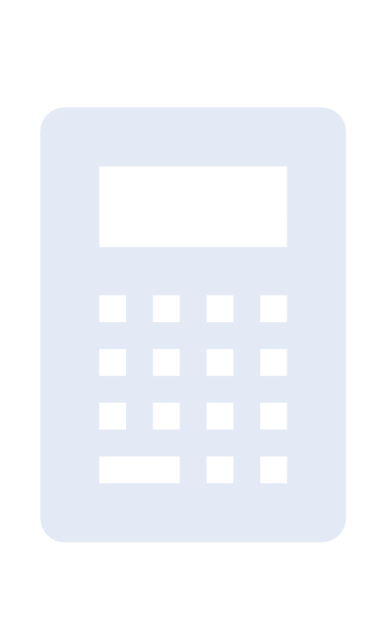
Project Title: Python Based GUI Calculator
Made By: GARIMA MAHAJAN
Institute: Digicrome

Slide 2
Project Overview
Python calculator(GUI application) constructed using Tkinter library in VS Code
Clickable buttons that perform core mathematical operations encompassing addition, subtraction, multiplication, and division
Allows the seamless execution of mathematical calculations
Yielding results coupled with the ability to clear the equation display

Slide 3
Problem Statement
Basic Python Calculator creation was known
To inculcate that knowledge for creating a Graphical User Interface CALCULATOR FOR ENHANCED VISUALISATION

Slide 4
Solution
To build Python Based GUI Calculator:
- Tkinter library was used to create the GUI interface
- Basic functions were employed

Slide 5
Methodology
The Tkinter library was utilizeed by importing it with the alias ‘tk’.
Python code was developed using VS Code
The ‘def’ keyword was used to declare the 3 functions:
- add_to_calculation
- evaluate_calculation
- clear_field
The ‘global’ keyword was utilized within the functions to establish global variables inside the function.
To create a GUI window, ‘tk.Tk()’ method is used, assigning the result to the variable ‘root’
To provide title to the GUI application, ‘title’ method of the ‘root’ window is utilized
The ‘mainloop’ method is called to ‘root’ window to execute and run Tkinter window

Slide 6
Methodology
The ‘try’ and ‘except’ keywords were employed inside evaluate_calculation to avoid any errors
Buttons are instantized as ‘tk.Button’ objects within the root window
Design Layout: The ‘grid’ method was used to arrange button(widgets) in table format(rows,columns)
Lambda function was used to have the particular expression evaluated only when called

Slide 7
Methodology
For each button, position was specified using row and column number
To bind the buttons to their respective function, the ‘command’ parameter was used
Paranthesis is removed in clear_field function button because the function is being passed as an argument and not called
Lambda is removed in clear and equals button since there is no parameter for the function in that case

Slide 8
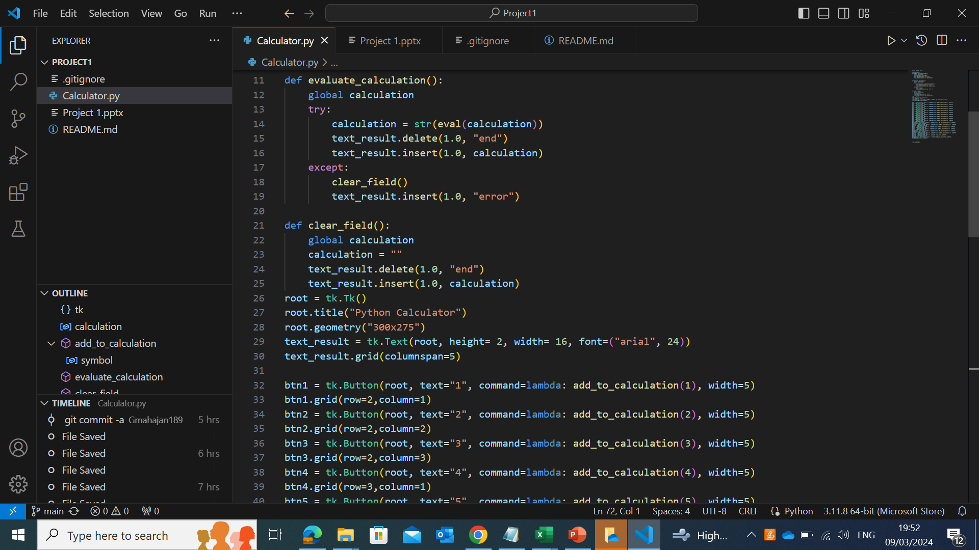
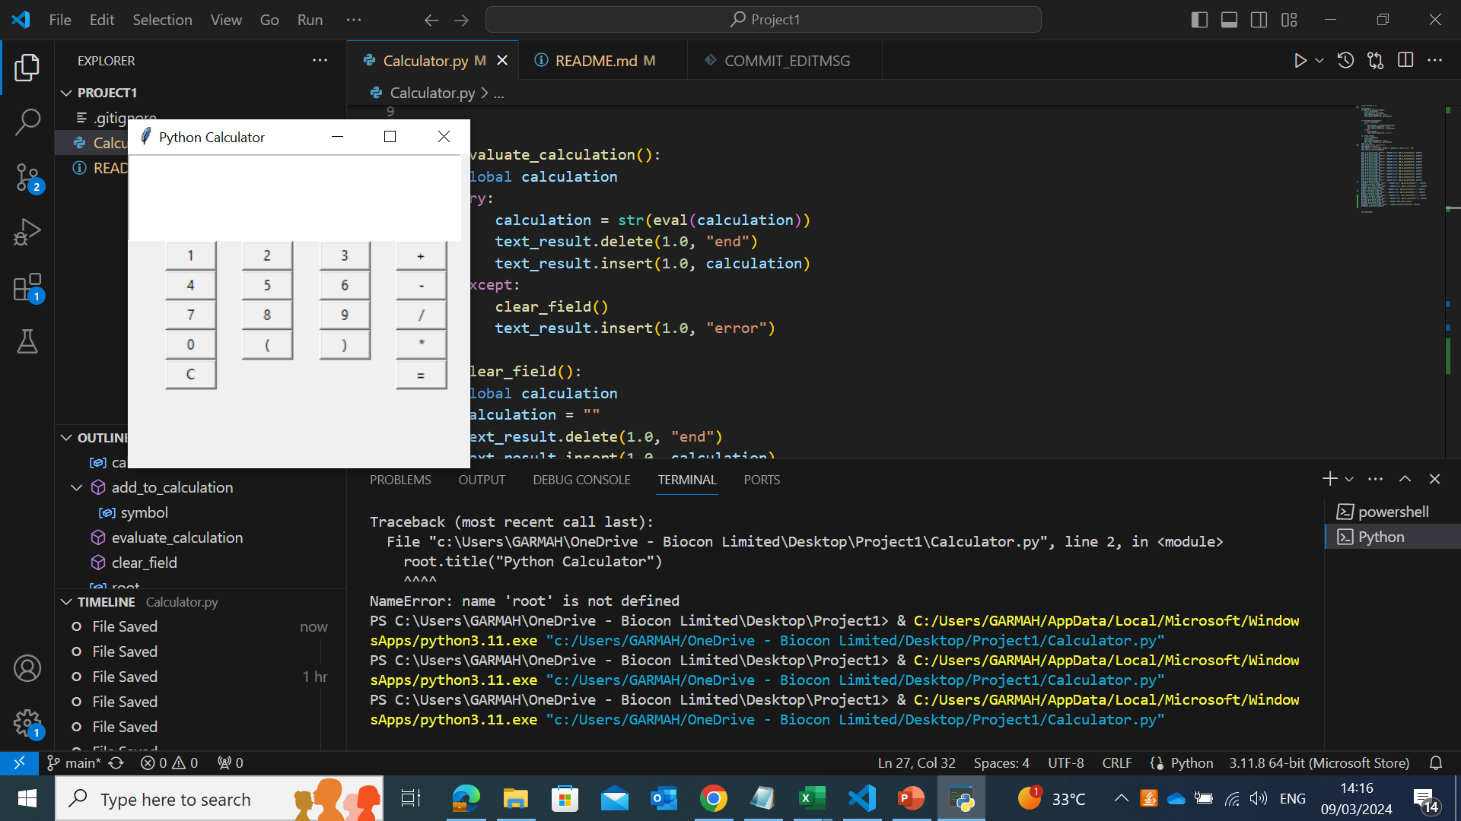
Key Features
The images display the VS Code interface and the final appearance of the Python Based GUI Calculator repectively

Slide 9
Results and Achievements
Tkinter library use for the creation of GUI interface
Core Python
Visual Studio Code(VS Code) for Python code
Application development using python code

Slide 10

THANK YOU!

